Slide 1
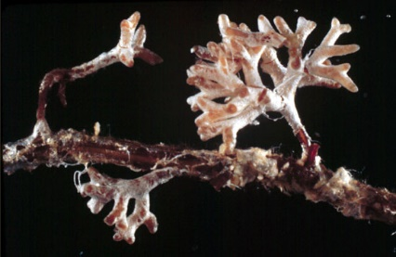

MycoMaxima® Data Sheet
Professional Grade Mycorrhizal Inoculant
MycoMaxima® is a professional grade ultra-concentrated Mycorrhizal inoculant containing
9 species of beneficial fungi to promote growth.
This professional grade Mycorrhizal inoculant intentionally does not include other microorganisms, nor does it include bio-stimulants, as the intent of this product is to be a mycorrhizal inoculant only of the highest purity available! The viability, purity and high concentration of MycoMaxima® ensures the highest degree of potential success.
MycoMaxima® contains Rhizophagus irregularis (syn. Glomus intraradices) an Arbuscular Mycorrhizae species and 8 species of Ectomycorrhizae. Individual species counts listed on reverse. Glomus intraradices associates with the vast majority of agricultural short term crops! Ectomycorrhizae associate with many conifers (i.e. hemlocks, firs and spruce) and hardwoods (i.e. pecans and oaks). For a complete list of plants and how they associate with, see our web site www.soilsecrets.com under the Details menu bar.
MycoMaxima® provides the following benefits:
Builds top soil and is essential for sequestering soil carbon
Increases crop yields
Improves drought tolerance
Improves uptake of mineral nutrients
Improves food nutrient density
Increases Phosphorus uptake, which promotes production of ATP, a
high energy molecule
Protects roots from damaging nematodes
Improves tolerance to environmental stress
Improves Profit
Contact us at:
505.866.7645
www.soilsecrets.com
info@soilsecrets.com

Slide 2
MycoMaxima® Data Sheet
Professional Grade Mycorrhizal Inoculant
Description: Mycorrhizal Spore Concentrate, in a dry powder
Color: White/tan
Solubility: NA
Compatibility: Avoid fungicides, and acid based Phosphate fertilizers
Contains non-plant food ingredients:
Species | Spores/lb | Spores/cc
Arbuscular Mycorrhizae: | 400,000 | 485
Rhizophagus irregularis (syn. Glomus intraradices) | 400,000 | 485
Total Count Arbuscular Mycorrhizae and Ectomycorrhizae combined: | 2,513,400,000 | 3,040,485
Pisolithus tinctorius | 1,860,000,000 | 2,250,000
Laccaria laccata | 125,000,000 | 150,000
Rhizopogon roseolus, R. subscaerelescens, R. villosulus, R. vulgaris | 264,000,000 | 320,000
Scleroderma cepa, S. citrinum | 264,000,000 | 320,000
Directions for Use and Application Rates:
Best use of a mycorrhizal inoculant is to apply the spores directly to the seed or the plant root as a dry application. Applying wet can cause too much material to stick to the subject causing an expensive waste of product. Mycorrhizal fungi will only germinate and grow in orchestration with the seed and roots of a living host plant, therefore attempting to cultured and grow them in compost tea, worm compost other non root environment cannot work. Spores can be watered into the rooting system!
Potted Plants: Mix 1 tsp/6 gallons water. |  | For hydroponics: 1 tsp / 30 gallons
Container Size | Amount of Solution
4 in. | 3 oz. | For Hydroseeding: 3 lbs / acre
1 gallon | 5 oz.
3 gallon | 16 oz. | For Agriculture: 12 oz. / acre
5 gallon | 32 oz.
Contact us at:
(505) 866-7645
www.soilsecrets.com
info@soilsecrets.com

