Slide 1
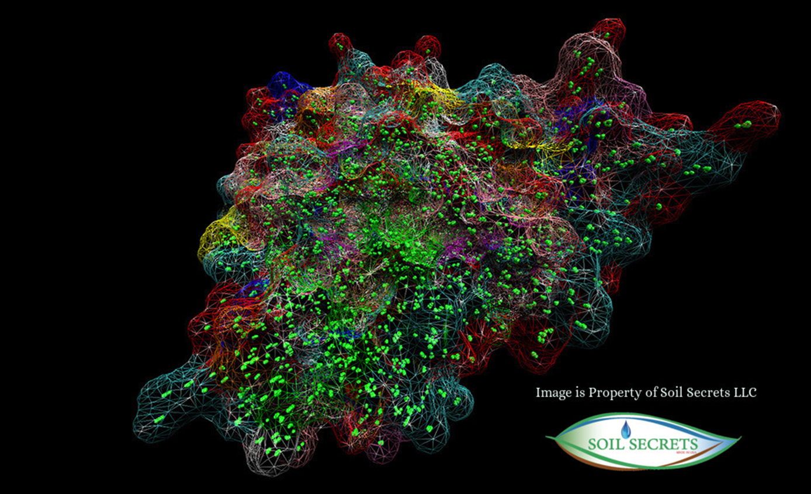

TerraPro® Data Sheet
Biomimetic Soil Carbon Ecology
Molecular Carbon is the Driving Force of Soil Ecology
TerraPro® Made for agriculture, lawn and garden, sports field construction, mine reclamation, and erosion control. TerraPro is biomimetic carbon based molecules that provide Aromatic Chemistry characteristics. In Nature’s soil ecology these carbon rich molecules provide many of the Mechanisms of Actions (benefits) involved with the bio-geo-chemical processes of plant nutrition, soil health and soil structure. The result is that the ecology of the soil improves, therefore improving the water and nutrient uptake of the vegetation.
TerraPro is a carbon rich Macro-Molecular Substance (huge molecules)clustered together into Supramolecular substances. Supramolecular means the molecules have organized and self assembled without an outside influence into larger substances. The larger Supramolecular substance is also crammed rich in “Functional Groups” the specific groups of atoms within the molecules that are responsible for the characteristic chemical reactions (what they do and how they do it). In Nature, under perfect conditions, these macro-molecular carbon substances form on the roots of plants and are the essence of soil carbon accumulation.
Agriculture Grade TerraPro® provides the following benefits:
Improves Profit by increasing crop yields
Supports healthier crops
Reduces fertilizer runoff
Assists in soil remediation
Supports soil microbial respiration
Increases root, water and oxygen penetration into soil by improving soil porosity
Improves water retention and drought tolerance of crop
Improves uptake mineral nutrients into the plant
Supports a healthy soil ecology which in turn decreases disease pressure
Reduces heat stress and other environmental stresses
Contact us at:
505.866.7645
www.soilsecrets.com
info@soilsecrets.com

Slide 2
TerraPro® Data Sheet
Professional Grade Biomimetic Soil Activator
Description: Granular Macro-Molecular Carbon based molecules
Color: Black
Molecular Description: 100% Characterized, with all Functional Groups
Contains non-plant food ingredients:
The carbon rich molecules of this product have been quantified and qualified under a Commercial Proprietary Information Contract with the National Nuclear Labs, where the Deliverables of the research and analysis provided a Molecular Characterization of TerraPro. This contract is exempt from the Freedom of Information Act. This characterization was performed down to a sub-atomic level and all Functional Groups were identified and quantified per molecule species.
Directions for Use and Application Rates:
Application Rates: Amount needed is determined by the needs of the site. Product can be top-dressed onto the surface and watered in., or lightly cultivated into the top ¼” to ½” inch. Going deeper may be necessary for Petroleum Hydrocarbon remediation and Sodium remediation. Orchard Management – product can be dribbled onto the surface in a line following the surface drip irrigation line. Sports Field Construction – for one time application during time of construction its recommended that a minimum of 10,000 lbs per acre be amended into the soil before planting of sod or seed. Other Agriculture – TerraPro can be broadcast spread onto the surface of perennial crops such as alfalfa, woody crops such as grapes and raspberry or crops such as cotton without the need to incorporate into the soil. Mine Reclamation/Erosion Control – Its recommended that TerraPro’s commercial powder formulation be used, allowing the product to be incorporated into a mechanically agitated Hydroseeding tank and sprayed out with a slurry of seed, wood fiber mulch, screened compost using Soil Secrets TTP Supreme Compost and organic nitrogen using Soil Secrets Protein Crumblies.
Contact us at:
505.866.7645
www.soilsecrets.com
info@soilsecrets.com

